Slide 1

Department of Computer Science and Engineering
Automated Traffic Sign Recognition via CNN Deep Learning
PRESENTED BY
Name of the Student : Narendra Yenuganti
Name of the Student : Ramu Avula
Name of the Student : Adi Madam
(Roll No.) 21471A05K9
(Roll No.) 21471A05E3
(Roll No.) 21471A05I0
Under the Guidance of,
K.V.Narasimha Reddy,
Assistant Professor,
Department of Computer Science and Engineering,
Narasaraopeta Engineering College (Autonomous), Narasaraopet- 522 601.
Review No.1
Department of CSE

Slide 2
OUTLINE
Abstract
Introduction
Literature Survey
Research Gaps
Problem Statement
Objectives
Block Diagram / Flow Diagram
Methodology
Implementation
Results and Analysis
Conclusion & Future Scope
References
Question and Answers
Acknowledgements
Review No.1
Department of CSE

Slide 3
ABSTRACT
The rapid development of the road traffic systems is a very important component of the nation’s infrastructure, and that is reflected in growing importance of the traffic safety. Traffic Sign Recognition (TSR) is an important field of research because traffic offenses, particularly the disregard for traffic signs, are a major contributor to accidents. This paper gives a comprehensive review of the latest developments in the area of traffic sign detection and recognition techniques with attention to the applications of CNNs. This paper discusses the need for traffic signs to be detected under complex conditions and proposes an architecture based on modified CNN that helps reduce the processing time and increase accuracy. Improving recognition accuracy in realistic environments is the motivation behind the CNN model, which has been architected for real-time training as well as target identification. Experiments suggest that this solution outperforms present intelligent driving systems and the state-of the-art performance achieved by the image processing algorithms currently in use and traffic sign datasets.
Review No.
Department of CSE

Slide 4
INTRODUCTION
Develops a Traffic Sign Recognition (TSR) system using Convolutional Neural Networks (CNNs).
Focuses on detecting and classifying traffic signs from images or video feeds in real-time.
Employs preprocessing techniques and a CNN architecture for efficient and accurate classification.
Addressing Road Safety: Traffic sign misinterpretation or neglect leads to accidents and fatalities.
Autonomous Vehicle Technology: Essential for enabling vehicles to make safe, rule-abiding navigation decisions.
Overcoming Traditional Method Limitations: Existing methods struggle with complex scenarios like dynamic lighting or occlusion, which this project aims to solve.
Minimizing Human Error: Provides reliable, automated solutions for traffic law compliance.
Enhancing Safety: Reduces accidents by ensuring traffic laws are followed accurately.
Critical for Autonomous Vehicles: Supports safe, automated decision-making
Review No.
Department of CSE

Slide 5
LITERATURE SURVEY
No | Title | Author | Journal Name & Year | Methodology Adapted | Key Findings | Gaps
1 | A Traffic Sign Recognition Method Under Complex Illumination Conditions | Chao Deng | IEEE Access, 2023 | Adaptive Image Enhancement, Feature Difference (FD) Model | Detection Accuracy Increase, Performance in Dark Conditions | Small Dataset Size, Generalization Under Complex Conditions
2 | A Lightweight Traffic Sign Recognition Model Based on Improved YOLOv5 | Wenchao Zhu | Researchgate,2023 | Model Selection, Ghost Module Implementation | Accuracy Enhancement, Speed and Efficiency | High Computational Costs, Speed vs. Accuracy Trade-off
3 | Detection and Recognition of Obscured Traffic Signs During Vehicle Movement | Shi Luo, Chenghang Wu | IEEE Access,2023 | Image Fusion for Recognition, Detection of Potential Traffic Signs | Improved Recognition Rates, Effective for Rectangular Signs | High computational requirements, Generalization to Diverse Environments
4 | Sign-YOLO: A Novel Lightweight Detection Model for Chinese Traffic Sign | W. Song and S. A. Suandi | IEEE Access, 2023 | Methodology Adapted, Training Process | Performance Improvement, Parameter Reduction | Detection Speed, Complex Backgrounds
5 | A low-cost, fully integer-based CNN accelerator for real-time traffic sign recognition. | Jin-Ku Kang, Yongwoo Kim | IEEE Access, 2023 | Hardware-Friendly Quantization, Parallelization Strategies | DL outperformed ML in image processing | High Accuracy, Resource Efficiency

Slide 6
RESEARCH GAPS
Handling Challenging Real-World Conditions:
Difficulty in accurately detecting traffic signs under extreme lighting conditions, occlusions, and varying perspectives.
Inconsistent performance when encountering weather-related challenges like rain, fog, or shadows.
Class Imbalance in Datasets
Imbalanced distribution of classes in datasets like GTSRB impacts the model's ability to generalize well for underrepresented sign types.
Processing Time for Real-Time Applications
High computational requirements and delays in detection affect real-time deployment, particularly in embedded systems like vehicles.
Generalization to Diverse Road Networks
Limited ability to extend the model's effectiveness to regions or countries with distinct traffic sign standards and designs
Review No.1
Department of CSE

Slide 7
PROBLEM STATEMENT
The project addresses the challenge of accurately and efficiently recognizing traffic signs in diverse, real-world conditions using Convolutional Neural Networks (CNNs). Traditional traffic sign detection methods, while effective in controlled environments, struggle with:
Real-world challenges like poor lighting, occlusion, and variable weather conditions.
Generalizing across diverse traffic sign designs and standards used globally.
Imbalanced datasets that limit the system's ability to classify less common traffic signs.
Enhanced Road Safety:Misinterpretation or missed recognition of traffic signs contributes to accidents, fatalities, and traffic rule violations.
Challenges with Real-World Application:The real-world environment presents issues such as occlusion, weather variations, and poorly maintained signage, which demand more advanced recognition systems than those currently available.
Review No.1
Department of CSE

Slide 8
OBJECTIVES
.
Development of an Accurate Traffic Sign Recognition Model:Design a robust Convolutional Neural Network (CNN) for detecting and classifying traffic signs with high precision.
Enhancement of Real-World Applicability:Address challenges like varying lighting conditions, occlusions, weather impacts, and diverse viewing angles.
Optimization for Real-Time Performance:Reduce computational complexity and improve processing speed to ensure the system operates in real-time environments.
Handling Class Imbalance in Datasets:Implement techniques like data augmentation or weighted loss functions to manage imbalanced datasets effectively.
Integration of Preprocessing Techniques:Utilize advanced preprocessing methods (e.g., Gaussian blur, HSV conversion, and binarization) to improve model performance.
Review No.1
Department of CSE

Slide 9
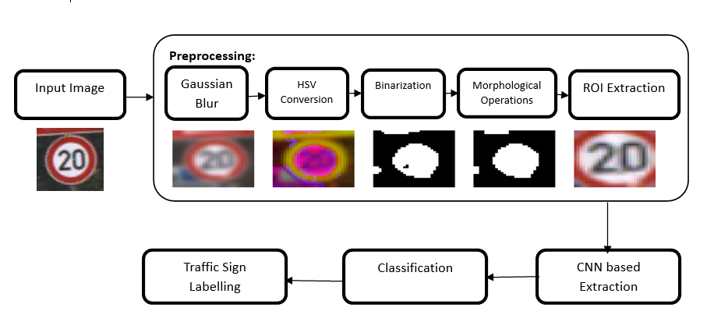
BLOCK DIAGRAM OR FLOW DIAGRAM
Review No.
Department of CSE

Slide 10

METHODOLOGY
Preprocessing Techniques:
Preprocessing is crucial to enhance the data quality for better model training and recognition. The following methods are employed:
Gaussian Blur: Removes noise from images while preserving key edges and details. A Gaussian kernel function is applied:
HSV Conversion: Converts images from the RGB color space to HSV (Hue, Saturation, Value) for better color-based segmentation, reducing the impact of lighting variations.
Binarization: Converts grayscale images into binary (black-and-white) format to emphasize essential features, helping distinguish the signs from noise.
Review No.
Department of CSE

Slide 11
METHODOLOGY
Morphological Operations:
Dilation: Enlarges the boundaries of sign regions.
Erosion: Removes small artifacts and shrinks regions of interest.
Closing: Fills small gaps in the object boundary to create more uniform shapes.
Region of Interest (ROI) Extraction: Segments the area containing the traffic sign, ignoring irrelevant parts of the image to improve accuracy and efficiency.
Normalization: Pixel values are normalized to [0,1] by dividing by 255, improving model convergence.
Frameworks and Tools:
Frameworks: TensorFlow, Keras (for deep learning).
Libraries: OpenCV (for preprocessing), NumPy (data manipulation), Matplotlib/Seaborn (for EDA and visualization).
Optimizer:Adam(adaptive learning rate).
Review No.
Department of CSE

Slide 12
IMPLEMENTATION
Software Specifications:
Programming Language: Python 3.10
Deep Learning Frameworks: TensorFlow and Keras
Libraries Used:
OpenCV: For image preprocessing techniques (Gaussian Blur, HSV conversion, etc.)
NumPy: For numerical operations and data manipulation.
Matplotlib/Seaborn: For visualization of data and results during EDA.
Development Environment:
Google Colab (cloud-based development environment for leveraging GPU resources)
Hardware Specifications:
Processor: Intel Core i7 / equivalent or higher (Cloud or Local Machine).
GPU: NVIDIA GPU (Colab GPU or a local setup with CUDA support).
RAM: Minimum 8GB (16GB recommended for smooth model training).
Storage: Dataset storage capacity of approximately 5GB.
Review No.
Department of CSE

Slide 13
IMPLEMENTATION
Dataset Imbalance: The dataset had uneven class distributions, addressed using data augmentation techniques and class-weighted loss during model training.
Diverse Real-World Conditions: Variations in lighting, occlusion, and weather made recognition difficult, resolved through preprocessing techniques like HSV conversion and morphological operations.
Overfitting: The model performed better on training data than validation data, mitigated using Dropout layers and implementing Early Stopping strategies.
High Computational Demand: Training CNN models required significant hardware resources, solved by leveraging Google Colab’s GPU support and optimizing computational processes.
Real-Time Constraints: Achieving real-time performance required optimized CNN architecture and using TensorFlow Lite to ensure low latency on edge devices.
Review No.
Department of CSE

Slide 14
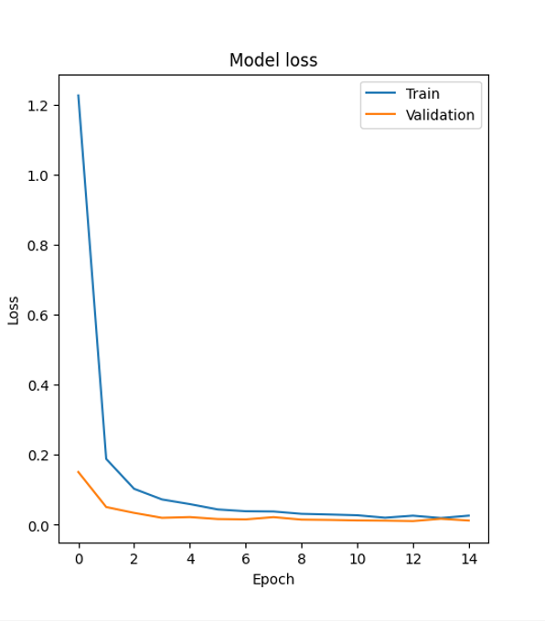
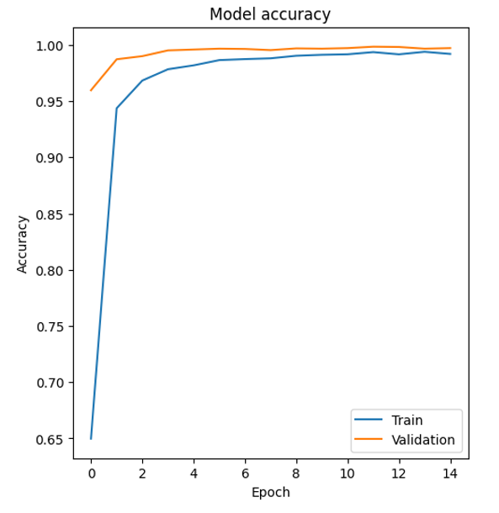
RESULTS & ANALYSIS
Model Evaluation:
The final stacked ensemble model achieved 99% accuracy, surpassing the baseline accuracy of 98%.
Accuracy Over Epochs:
Training and validation accuracy increase steadily, showing strong convergence.
The figures indicates the Model Accuracy and Model Loss
Loss Over Epochs:
Training and validation losses reduce, indicating a well-trained model.
Fig: Model Loss
Stakeholder Feedback
Stakeholders praised the model's accuracy and its ability to improve maintenance scheduling and minimize downtime.
Timely alerts for severe engine conditions were especially appreciated.
Fig: Model Accuracy
Review No.
Department of CSE

Slide 15
CONCLUSION and FUTURE SCOPE
The CNN model achieved high accuracy on both training (99.69%) and validation data (99.67%), validating its robustness and reliability.
Effective preprocessing techniques (e.g., HSV conversion, morphological operations) significantly improved the recognition of traffic signs in diverse conditions.
Advanced architectural enhancements, such as Dropout layers and Early Stopping, helped mitigate overfitting and stabilized performance.
Global Dataset Integration: Expand training datasets to include traffic signs from multiple countries, improving global applicability.
Lightweight Models: Develop and test more compact architectures (e.g., MobileNet, Tiny-YOLO) for real-time applications.
Explainable AI: Incorporate interpretability mechanisms to make predictions understandable, enhancing trust in autonomous systems.
Class Imbalance: Despite using augmentation, class imbalances remain a limitation, potentially reducing accuracy for rare signs.
Dataset Diversity: The model is trained predominantly on the GTSRB dataset, limiting its generalization to non-European traffic signs.
Review No.
Department of CSE

Slide 16
REFERENCES
C. Liu, S. Li, F. Chang and Y. Wang, ”Machine Vision Based Traffic Sign Detection Methods: Review, Analyses and Perspectives,” IEEE Access, vol. 7, pp. 86578-86596, 2019, doi: 10.1109/ACCESS.2019.2924947
X. Peng, X. Chen and C. Liu, ”Real-time traffic sign text detection based on deep learning,” IOP Conf. Ser. Mater. Sci. Eng., vol. 768, Mar. 2020.
Y. Du, X. Zhang, G. Zhang and W. Sun, ”Detection and recognition of text traffic signs above the road,” Int. J. Sensor Netw., vol. 35, no. 2, pp. 69-78, 2021.
William, Marco Magdy, Pavly Salah Zaki, Bolis Karam Soliman, Kero los Gamal Alexsan, Maher Mansour, Magdy El-Moursy, and Kerolos Khalil. ”Traffic signs detection and recognition system using deep learn ing.” In 2019 Ninth international conference on intelligent computing and information systems (ICICIS), pp. 160-166. IEEE, 2019.
X. Qiao, ”Research on Traffic sign recognition based on CNN Deep Learning Network,” Procedia Computer Science, vol. 228, pp. 826-837, 2023.
A. Alam and Z. A. Jaffery, ”Indian traffic sign detection and recog nition,” International Journal of Intelligent Transportation Systems Research, vol. 18, pp. 98-112, 2020.
Y. Liu and W. Zhong, ”A novel SVM network using HOG feature for prohibition traffic sign recognition,” Wireless Communications and Mobile Computing, vol. 2022, 2022.
Y. Zhu, C. Zhang, D. Zhou, X. Wang, X. Bai, and W. Liu, ”Traffic sign detection and recognition using fully convolutional network guided proposals,” Neurocomputing, vol. 214, pp. 758-766, 2016.
Review No.
Department of CSE

Slide 17
REFERENCES
S. Mehta, C. Paunwala, and B. Vaidya, ”CNN based traffic sign classification using adam optimizer,” In 2019 international conference on intelligent computing and control systems (ICCS), pp. 1293-1298. IEEE, 2019.
L. Jia, X. Shi, and L. Wei, ”Design of Traffic Sign Detection and Recognition Algorithm Based on Template Matching,” In 2020 IEEE 2nd International Conference on Civil Aviation Safety and Information Technology (ICCASIT), pp. 237-240. IEEE, 2020.
Z. Fazekas, G. Bal´azs, A. Boulmakoul, and P. G´asp´ar, ”Visualization of traffic sign related rules used in road environment-type detection,” In 2019 Modern Safety Technologies in Transportation (MOSATT), pp. 53-57. IEEE, 2019.
A. Aksjonov and V. Kyrki, ”Rule-based decision-making system for autonomous vehicles at intersections with mixed traffic environment,” In 2021 IEEE International Intelligent Transportation Systems Conference (ITSC), pp. 660-666. IEEE, 2021.
M. Anandhalli and V. P. Baligar, ”An approach to detect vehicles in multiple climatic conditions using the corner point approach,” J. Intell. Syst., vol. 27, no. 3, pp. 363-376, Jul. 2018.
L. L. Li, ”Image edge detection algorithm and its application in traffic video segmentation,” 2015.
Y. Jin, Y. Fu, W. Wang, J. Guo, C. Ren and X. Xiang, ”Multi-feature fusion and enhancement single shot detector for traffic sign recognition,” IEEE Access, vol. 8, pp. 38931-38940, 2020.
S. He et al., ”Automatic Recognition of Traffic Signs Based on Vi sual Inspection,” IEEE Access, vol. 9, pp. 43253-43261, 2021, doi: 10.1109/ACCESS.2021.3059052

Slide 18
ACKNOWLEGEMENTS
We express our gratitude to Narasaraopeta Engineering College for providing the resources and infrastructure necessary to carry out this research.
Special thanks to K.V.Narasimha Reddy and Dr. Sireesha Moturi for their expert guidance, constructive feedback, and continuous encouragement throughout the project.
We sincerely express our gratitude for the opportunity to present this work on Traffic Sign Recognition using Convolutional Neural Networks. It is a privilege to contribute to advancements in road safety and intelligent transportation systems.
We appreciate the support and guidance from mentors, colleagues, and all those who helped bring this project to fruition.
Review No.
Department of CSE

